Slide 1


Iterative Process for Self-Repairing Robots
Renzo Caballero
Eric Feron

Slide 2
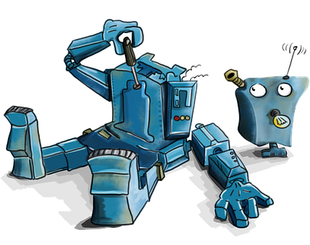
Imagine all electronic devices could repair them self.
Not at once! But by steps…

Slide 3
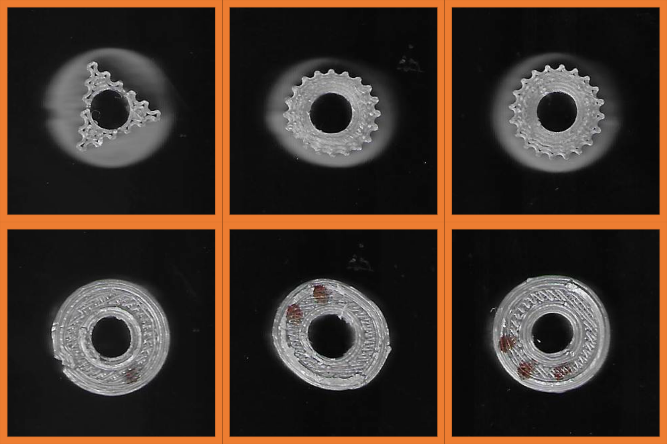

Slide 4
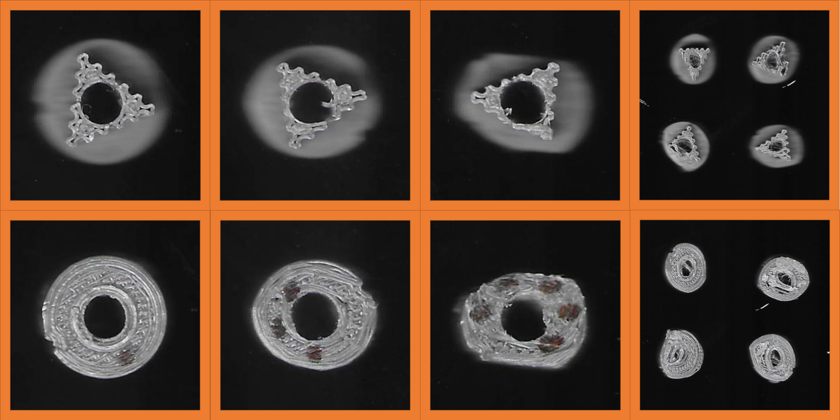

Slide 5
